Slide 1
Capstone Presentation

Slide 2
Introduction
Toronto is the provincial capital of Ontario and the most populous city in Canada, with a population of 2,731,571 in 2016. Current to 2016, the Toronto census metropolitan area (CMA), of which the majority is within the Greater Toronto Area (GTA), held a population of 5,928,040, making it Canada's most populous CMA. Toronto is the fastest growing city in North America, and is the anchor of an urban agglomeration, known as the Golden Horseshoe in Southern Ontario, located on the northwestern shore of Lake Ontario. Toronto is an international centre of business, finance, arts, and culture, and is recognized as one of the most multicultural and cosmopolitan cities in the world.

Slide 3
Background & Problem
“ABC”, a company based in Toronto, is responsible for organizing corporate retreat events. The company must put together a list tailored for their clients needs that includes hotels for their stay, halls for meetings/presentations, nearby parks for down time, nearby restaurants.

Slide 4
Data Description
I will utilize data provided by Foursquare location data. The data will be grouped by area, and include the information about the area and hotels, parks and restaurants.
This was allow clients to pick the area of the city that is best for them, so that they have good access to hotels, restaurants and parks during their stay.

Slide 5
Methodology
To begin all necessary libraries were imported. This included those necessary for handling request, data analysis, and handling data in a vectorized manner. As well as a module to convert an address into latitude and longitude, library for displaying images, and another for transforming a json file into a pandas dataframe library, finishing with a plotting library. Folowing this foursquare credentials and the city were defined, along with latitude and longitude values for the city.
Next came the search for the key venues for the city that were identified, hotels, parks and restaurants. The same steps were employed for each. An initial search, followed by a get request and examining results, assigning the relevant part of the JSON to the venue and transforming the venue into a dataframe, the remainder involved cleaning the dataframe for each venue. Lastly, a map was generated to visualize the venues.

Slide 6
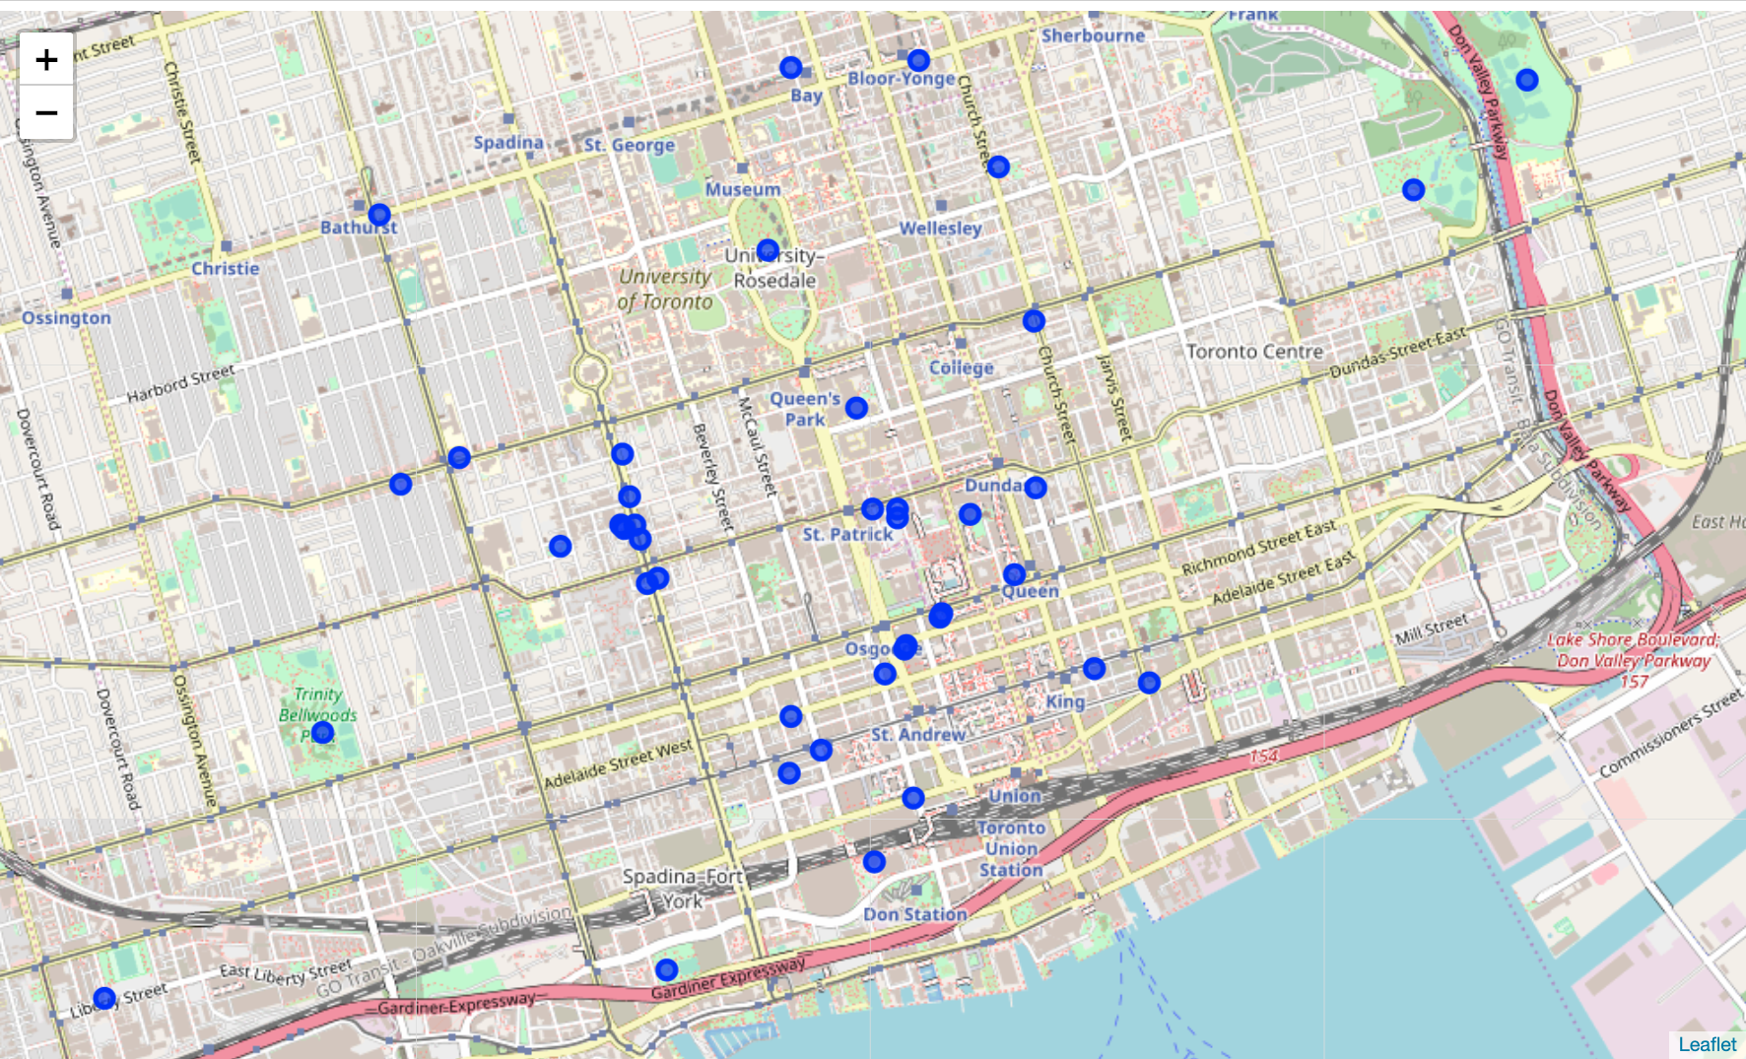
Results
42 different venues (Hotels, restaurants and parks) were identified for visualization.

Slide 7
Discussion & Conclusions
The company ABC wanted to easily show their clients venues needed for a trip to the city of Toronto.
The analysis performed here allows a client to easily visualize the venues available for them. This allows them to make choices for their stay.

